Slide 1


Atliq Hardware
Consumer Good Ad-hoc Insights
Presented by :- Abhishek Jaikaran Yadav

Slide 2
Codebasics SQL Challenge
The challenge consisted of answering 10 ad-hoc requests for business insights, which required me to run SQL queries and present the results in a way that would be meaningful and accessible to top-level management.
Consumer Goods Ad_Hoc query results and Insights Analysis

Slide 3
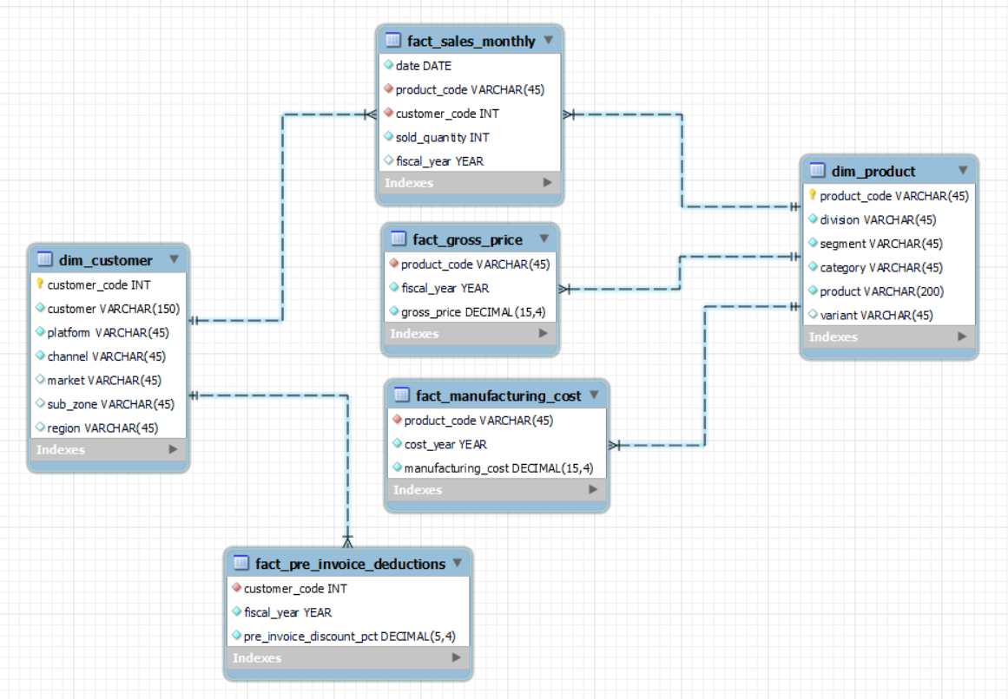
Entity Relationship Model of Data

Slide 4
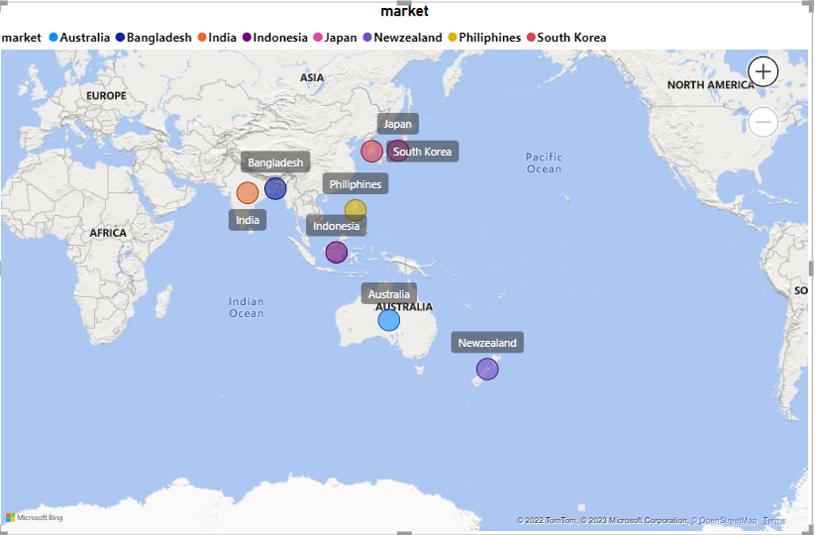
Request 1:- Provide the list of markets in which customer "Atliq Exclusive" operates its business in the APAC region.
market
India
Indonesia
Japan
Philiphines
South Korea
Australia
Newzealand
Bangladesh
Insights
The Customer ‘Atliq Exclusive’ operates its business in 8 major markets in the APAC Region.

Slide 5
Request 2:- What is the percentage of unique product increase in 2021 vs. 2020?
The final output contains these fields,
unique_products_2020,
unique_products_2021,
percentage_chg
unique_products_2020 | unique_products_2021 | percentage_chg
245 | 334 | 36.3
Insights
With a 36.3% increase in unique products in 2021.

Slide 6
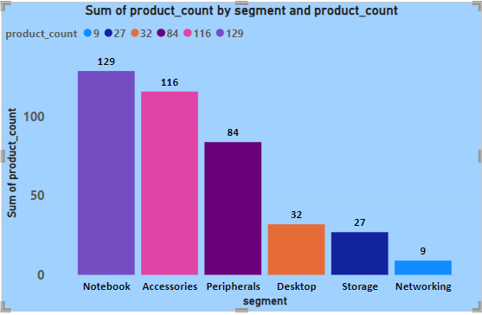
Request 3:- Provide a report with all the unique product counts for each segment and
sort them in descending order of product counts.
The final output contains 2 fields, Segment,product_count
segment | product_count
Notebook | 129
Accessories | 116
Peripherals | 84
Desktop | 32
Storage | 27
Networking | 9
Insights
We have a wide range of products under segment like Notebook, Accessories, Peripherals, Desktop, Storage and Network.
Number of unique Product in Notebook segment is very high and Networking segment is very less unique product.

Slide 7
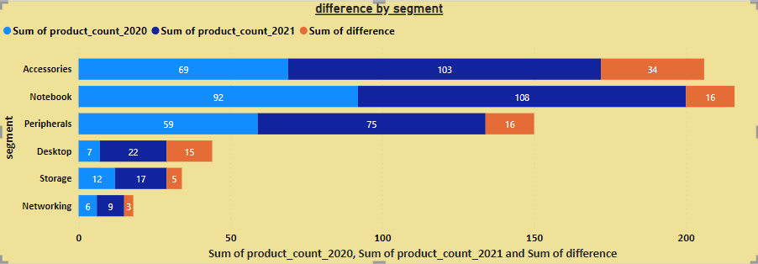
Request 4:- Follow-up: Which segment had the most increase in unique products in 2021 vs 2020?
The final output contains these fields,
Segment,product_count_2020,product_count_2021,difference
segment | product_count_2020 | product_count_2021 | difference
Accessories | 69 | 103 | 34
Notebook | 92 | 108 | 16
Peripherals | 59 | 75 | 16
Desktop | 7 | 22 | 15
Storage | 12 | 17 | 5
Networking | 6 | 9 | 3
Insights
Accessories segment has the highest increase in the number of 34 new products.
Notebook and Peripherals each has an increment of 16 new unique products
Desktop segment has the increment of 15 new products in the year 2021
Storage segment has the increment of only 5 new products
Networking segment is at the bottom with 3 new products in the year 2021

Slide 8
Request 5:- Get the products that have the highest and lowest manufacturing costs.
The final output should contain these fields,
product_code
product
manufacturing_cost
product_code | product | manufacturing_cost
A6120110206 | AQ HOME Allin1 Gen 2 | 240.54
A2118150101 | AQ Master wired x1 Ms | 0.89
Insights
AQ HOME Allin1 Gen 2 has the highest manufacturing costs of $240.54
AQ Master wired x1 Ms has the lowest manufacturing costs of $0.89

Slide 9
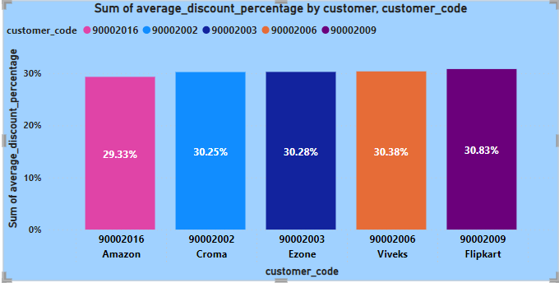
Request 6:- Generate a report which contains the top 5 customers who received an
average high pre_invoice_discount_pct for the fiscal year 2021 and in the Indian market.
The final output contains these fields,
customer_code
customer
average_discount_percentage
customer_code | customer | average_discount_percentage
90002009 | Flipkart | 30.83%
90002006 | Viveks | 30.38%
90002003 | Ezone | 30.28%
90002002 | Croma | 30.25%
90002016 | Amazon | 29.33%
Insights
Flipkart has received the highest pre invoice discount percent i.e., 30.83%

Slide 10
Request 7:-
Get the complete report of the Gross sales amount for the customer “Atliq Exclusive” for each month. This analysis helps to get an idea of low and high-performing months and take strategic decisions. The final report contains these columns:
Month
Year
Gross sales Amount
month | year | gross_sales_amount
September | 2019 | 9092670.339
October | 2019 | 10378637.6
November | 2019 | 15231894.97
December | 2019 | 9755795.058
January | 2020 | 9584951.939
February | 2020 | 8083995.548
March | 2020 | 766976.4531
April | 2020 | 800071.9543
May | 2020 | 1586964.477
June | 2020 | 3429736.571
July | 2020 | 5151815.402
August | 2020 | 5638281.829
September | 2020 | 19530271.3
October | 2020 | 21016218.21
November | 2020 | 32247289.79
December | 2020 | 20409063.18
January | 2021 | 19570701.71
February | 2021 | 15986603.89
March | 2021 | 19149624.92
April | 2021 | 11483530.3
May | 2021 | 19204309.41
June | 2021 | 15457579.66
July | 2021 | 19044968.82
August | 2021 | 11324548.34

Slide 11
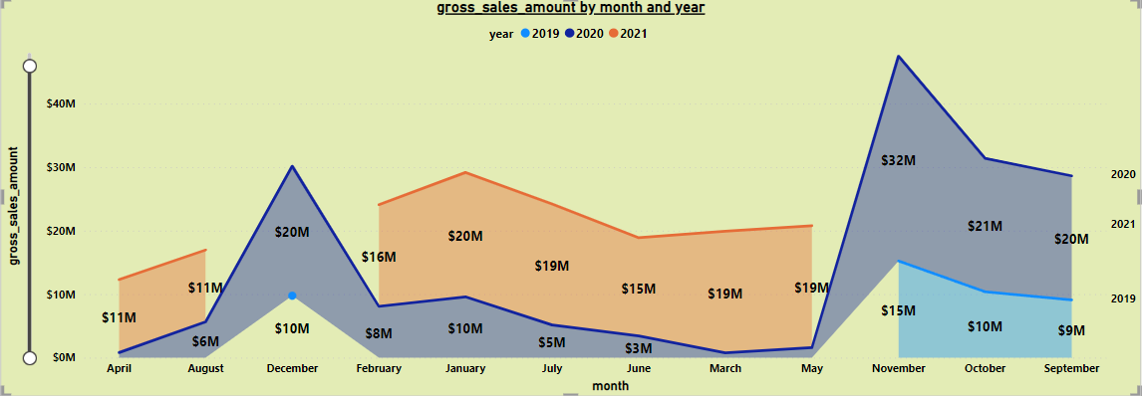
Insights
For Atliq Exclusive Store, maximum sales were recorded in November 2020 and lowest sales recorded in March 2020
Low sales from March to August
Sales started improving from September 2020

Slide 12
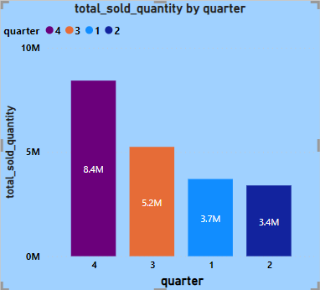
Request 8:- In which quarter of 2020, got the maximum total_sold_quantity?
The final output contains these fields sorted by the total_sold_quantity,
Quarter
total_sold_quantity
quarter | total_sold_quantity
4 | 8425822
3 | 5246770
1 | 3704398
2 | 3395899
Insights
Q4 had the maximum quantity sold for FY 2020
quantity dropped in Q2
Increase in sales recorded in Q3 and Q4

Slide 13
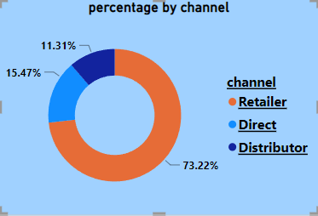
Request 9:- Which channel helped to bring more gross sales in the fiscal year 2021
and the percentage of contribution? The final output contains these fields,
channel
gross_sales_mln
percentage
channel | gross_sales_mln | percentage
Retailer | 1924170398 | 73.22%
Direct | 406686873.9 | 15.47%
Distributor | 297175879.7 | 11.31%
Insights
Retailers with 73.23% of gross sales for FY 2021, which was followed by Direct and Distributor channel with 15.47% and 11.31% of gross sales for FY 2021.

Slide 14
Request 10:- Get the Top 3 products in each division that have a high total_sold_quantity in the fiscal_year 2021? The final output contains these fields,
division,
product_code,
Product,
total_sold_quantity,
rank_order
division | product_code | product | total_sold_quantity | rank_order
N & S | A6720160103 | AQ Pen Drive 2 IN 1 | 701373 | 1
N & S | A6818160202 | AQ Pen Drive DRC | 688003 | 2
N & S | A6819160203 | AQ Pen Drive DRC | 676245 | 3
P & A | A2319150302 | AQ Gamers Ms | 428498 | 1
P & A | A2520150501 | AQ Maxima Ms | 419865 | 2
P & A | A2520150504 | AQ Maxima Ms | 419471 | 3
PC | A4218110202 | AQ Digit | 17434 | 1
PC | A4319110306 | AQ Velocity | 17280 | 2
PC | A4218110208 | AQ Digit | 17275 | 3

Slide 15
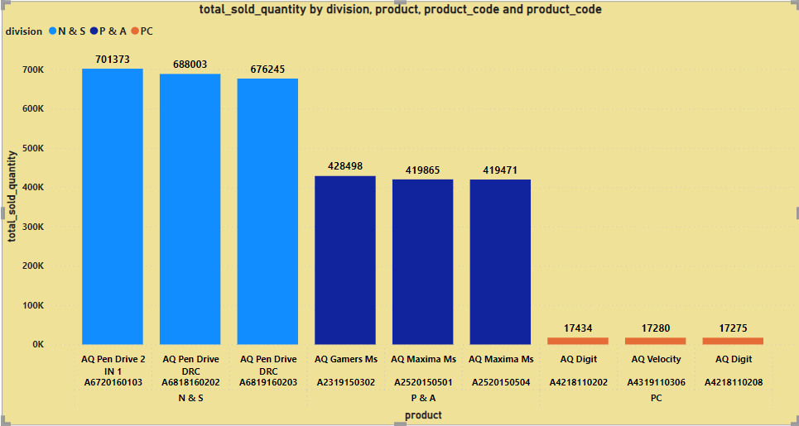
Insights
For N&S, the top selling product is AQ Pen Drive 2 IN 1 with a total of 7,01,373 quantities sold in FY 2021 followed by two variants of AQ Pen Drive DRC with 6,88,003 and 6,76,245 quantity sold respectively.
For P&A, top selling product is AQ Gamers Ms with 4,28,498 quantities sold followed by two variants of AQ Maxima Ms with 4,19,865 and 4,19,471 quantity sold respectively.
For PC, top selling product is AQ Digit PC with 17,434 quantities sold followed by AQ Velocity PC with 17,280 and AQ Digit PC with 17,275 quantity sold respectively.

Slide 16
Thank You

